Slide 1
InformaCast Wearable Alert Badge Overview
Empowering Staff. Accelerating Response. Protecting Students.

Slide 2
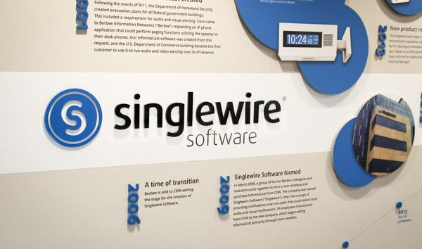


Who is Singlewire Software?
A trusted school safety vendor with 20+ years helping K-12 schools protect students and staff daily.
Provider of reliable, easy-to-use communication and safety tools for emergency and daily operations.
A proud partner of The “I Love U Guys” Foundation and Make Our Schools Safe

Slide 3

Why We Need This Solution
Seconds count when issues arise
Delays can escalate situations and risk
Staff often resort to using unreliable or time consuming methods to request help
We need to know who needs help and where they are as quickly as possible
We want to stay ahead of potential future legislation requirements

Slide 4
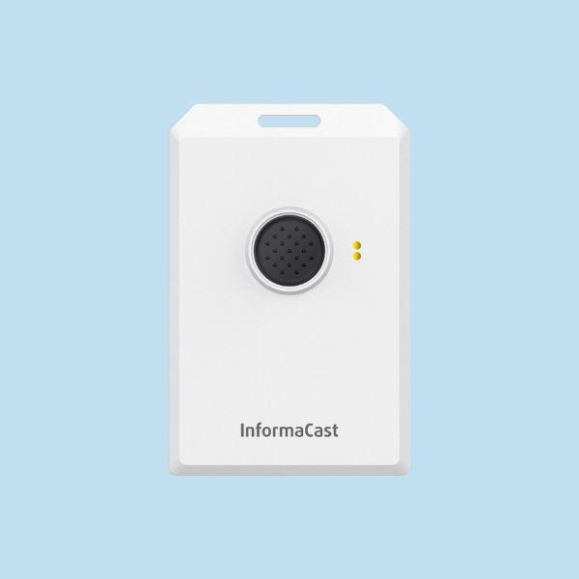
How the Badge Works
The InformaCast Wearable Alert Badge:
Offers a discreet, wearable device that lets staff request immediate assistance
Comes with two button press options for staff assistance and school-wide emergencies
Provides floor- and room-level accurate location information
Is backed by a robust critical communication and incident management software

Slide 5

Everyday Staff Support
Staff press the button three times to request help for:
Disruptive students
Fights in a hallway or classroom
Health concern (vomiting, fainting, headaches, etc.)
Building issues or vandalism
School leaders receive name and location to direct assistance

Slide 6
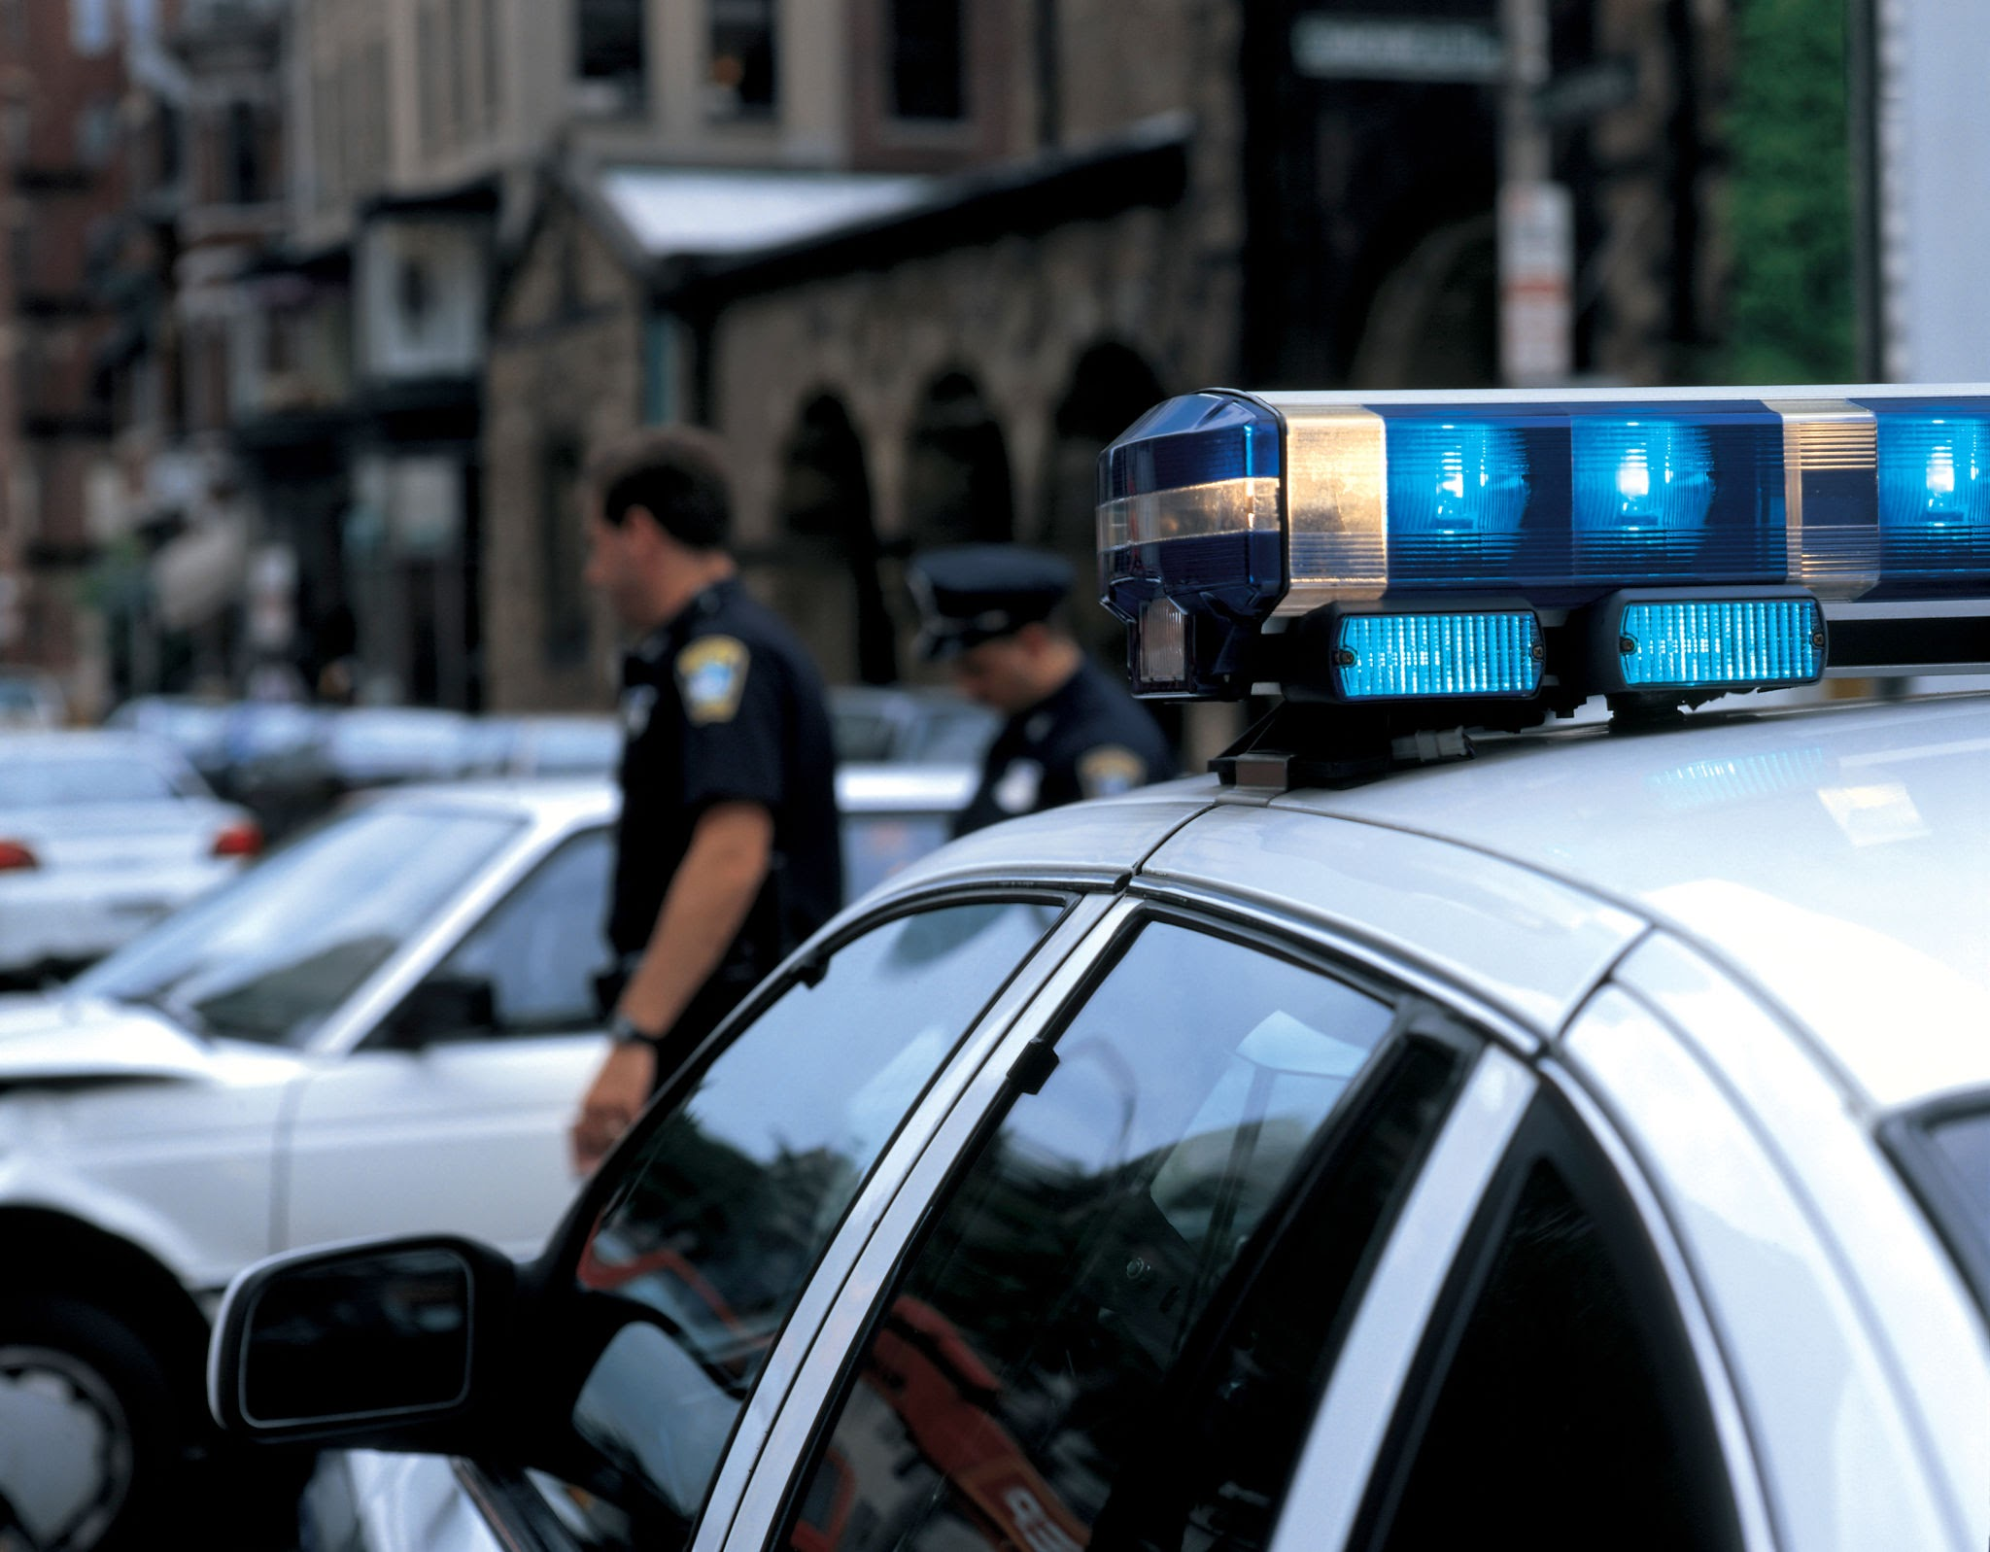
Critical Emergency Support
Staff press the button six times to signal a large-scale emergency, like:
Violent intruder
Active shooter
Medical emergency (heart attack, stroke, broken bones, etc.)
Fire, gas leak, chemical spill, or other severe building issue
Alerts are broadcast throughout the school and can directly notify first responders

Slide 7
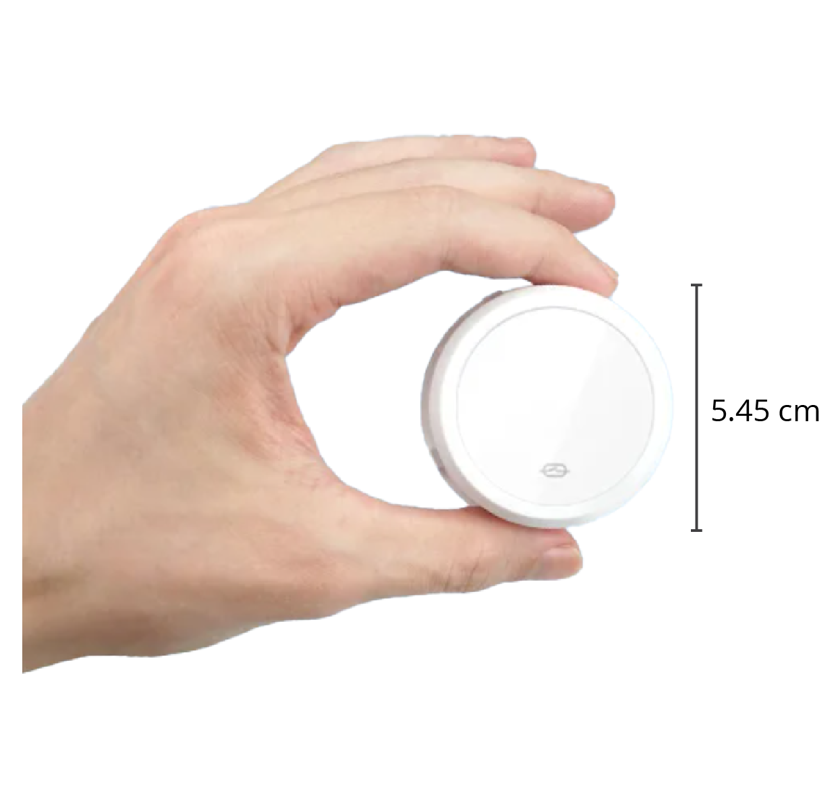
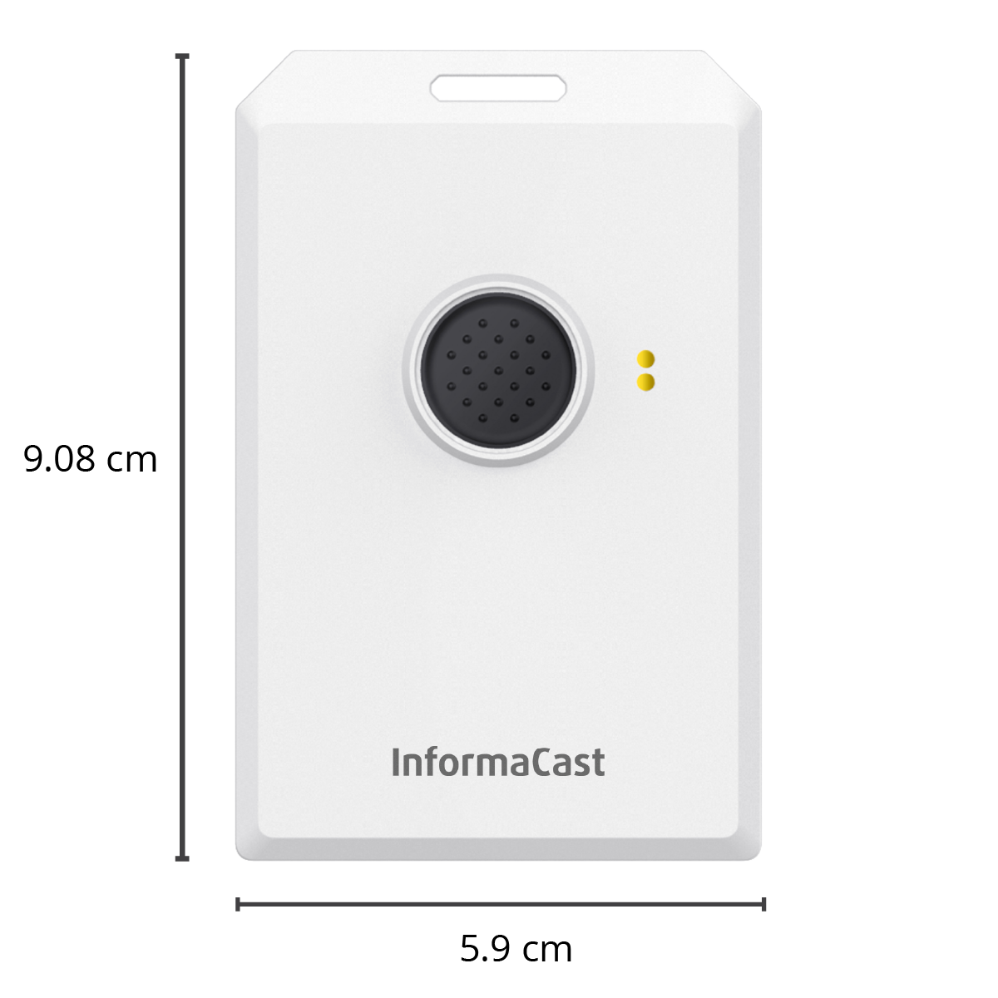
Why This Badge?
Only wearable built exclusively for the InformaCast platform
Send targeted alerts that include location on a map
Reach first responders
Deliver text, audio, and visual alerts to on-site and mobile devices
Two button press options for daily and emergency issues
Built-in safeguards to prevent accidental activation
Scalable for future expansion
1-year rechargeable battery

Slide 8
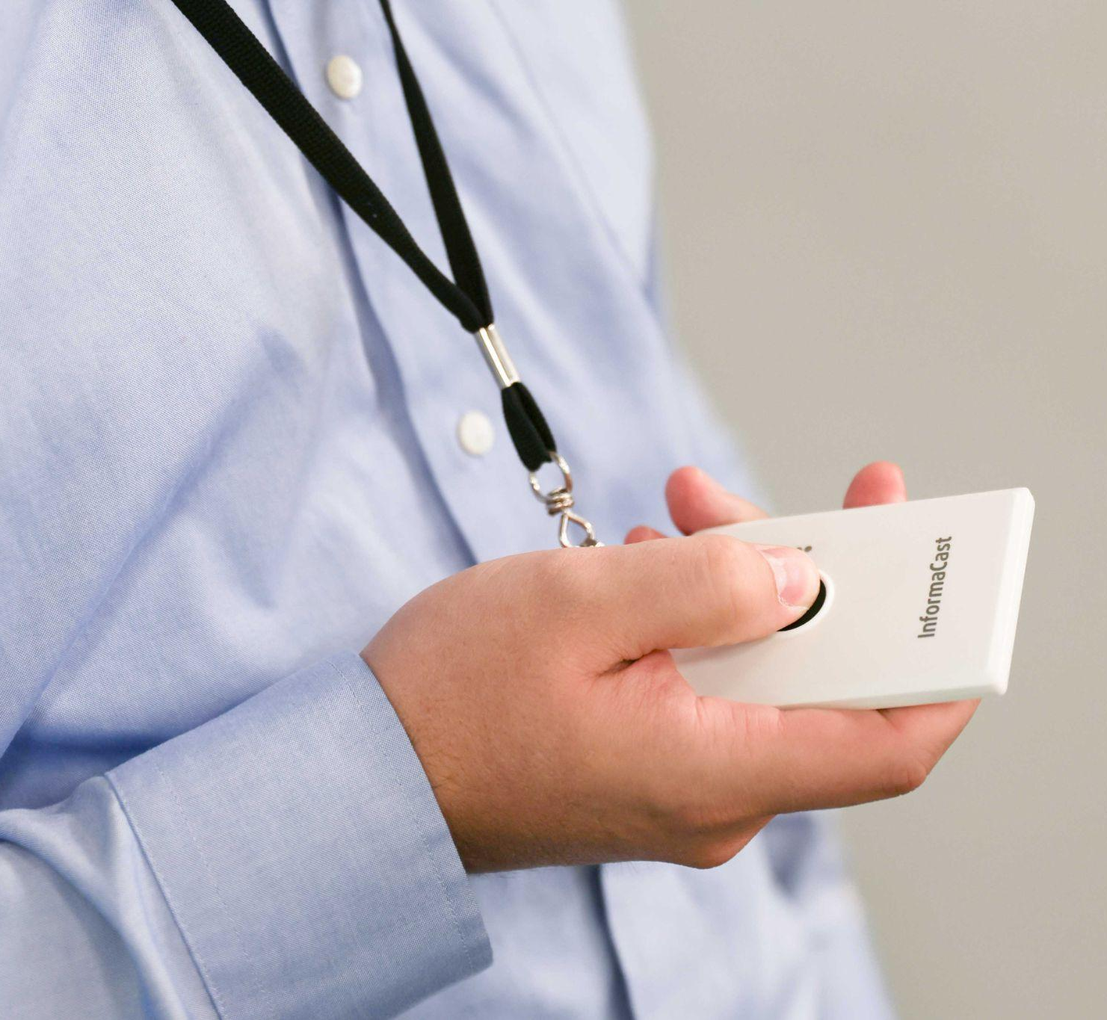
Addressing Potential Concerns
False alarms
Requires multiple presses to activate
Won’t activate with a single press or by being held down
Tracking
Staff are only tracked when badge is activated
Tracking ends when incidents are resolved
Failures
Battery life lasts for 1-year per charge
LEDs let staff know if message has been received
InformaCast software offers additional methods to activate alerts

Slide 9
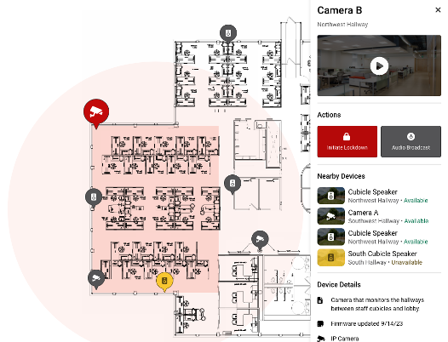
How Does It Work?
Staff are assigned badges
When issues arise they have two options:
3 presses - Staff (fight in the hall, health concern)
6 presses - organization-wide emergency (active shooter)
Badge receives location from nearby BLE Beacons
Notifications go out with location highlighted on a map
Individual is only tracked when badge is activated
Tracking ends when an incident is resolved

Slide 10
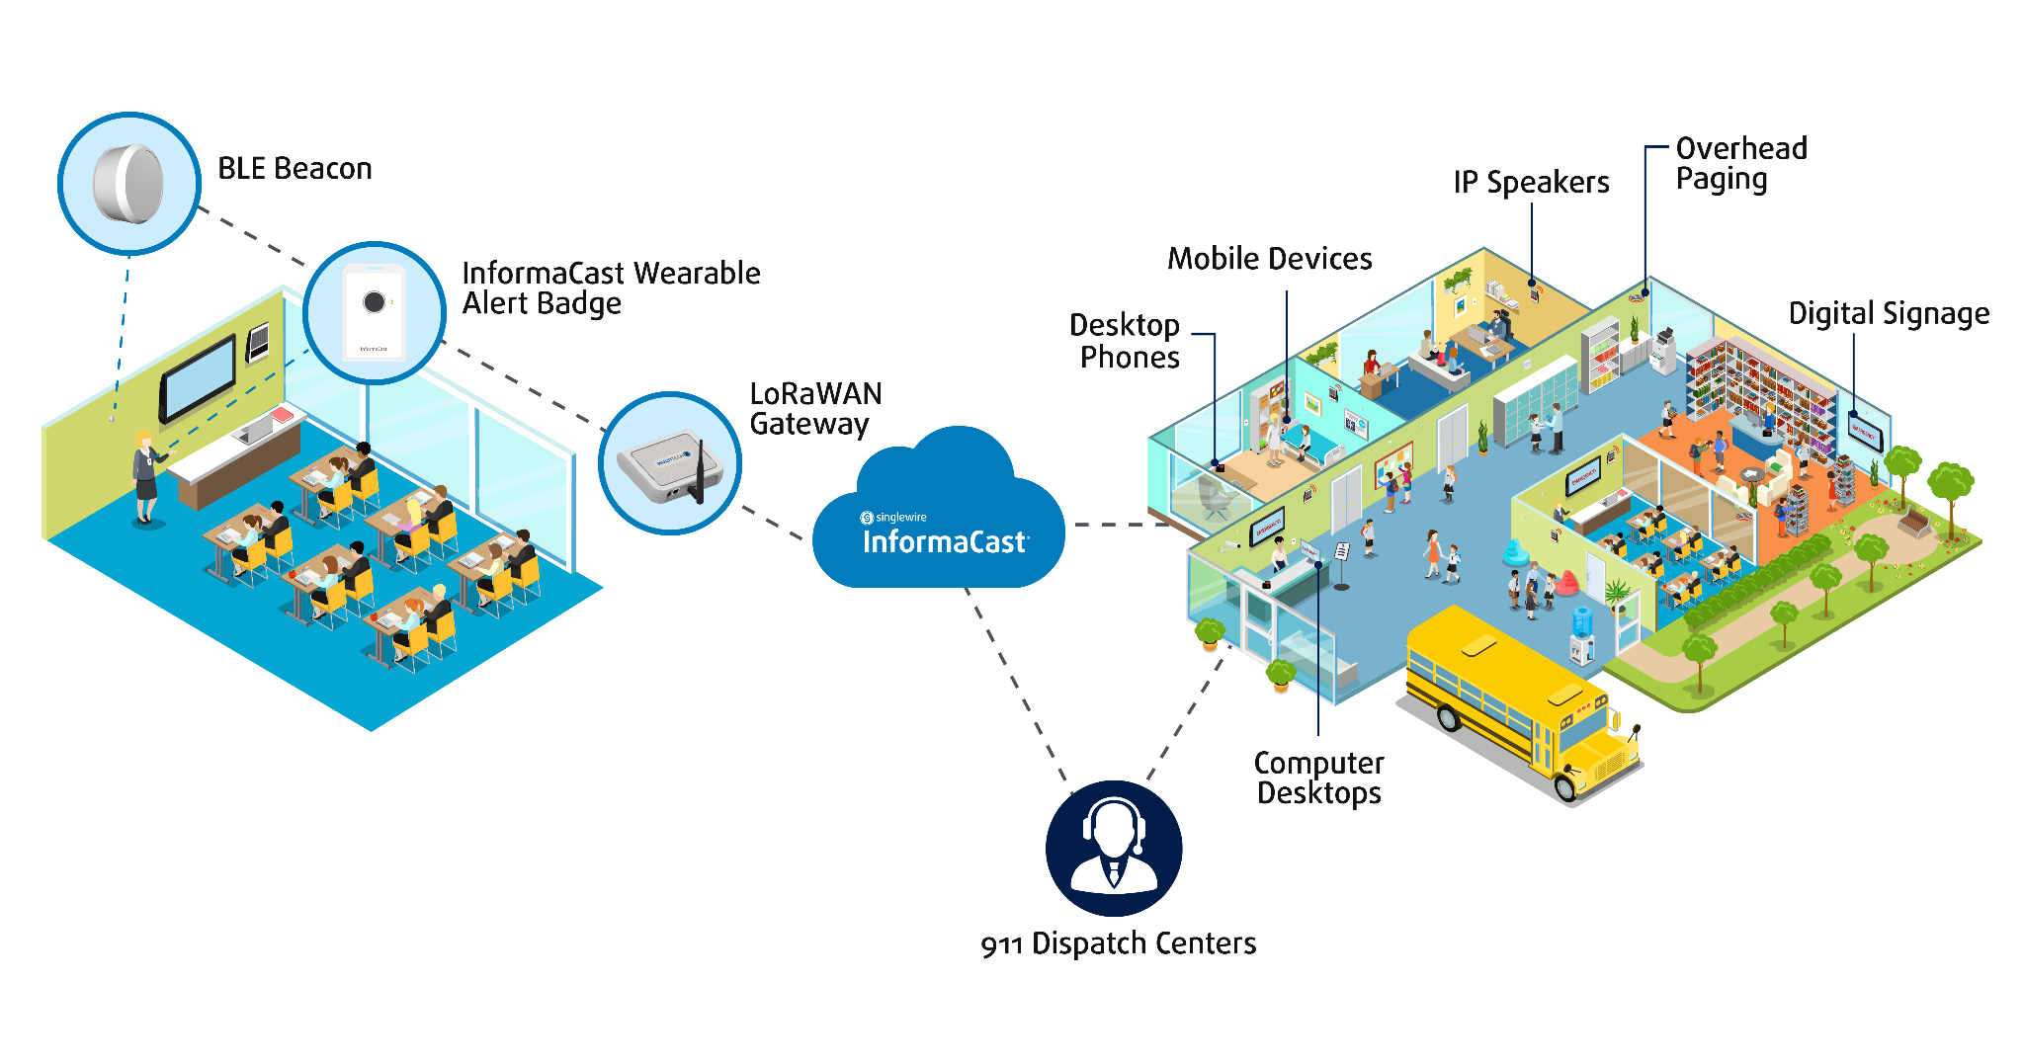
How Does It Work? (cont.)

Slide 11
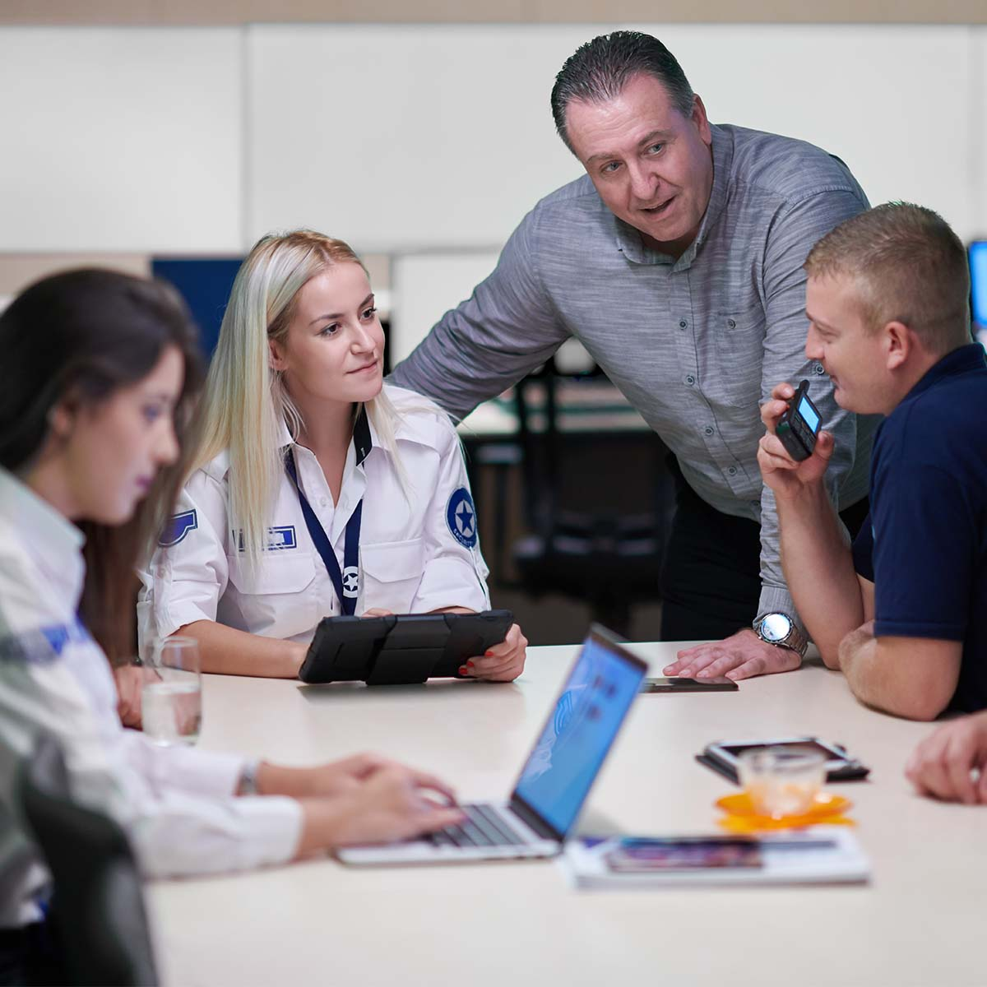
What We Hope to Achieve
Staff feel empowered and supported
School leaders gain clearer awareness of incidents
Better collaboration for a calmer, faster, more consistent response
Becomes a physical representation of our commitment to student safety

Slide 12
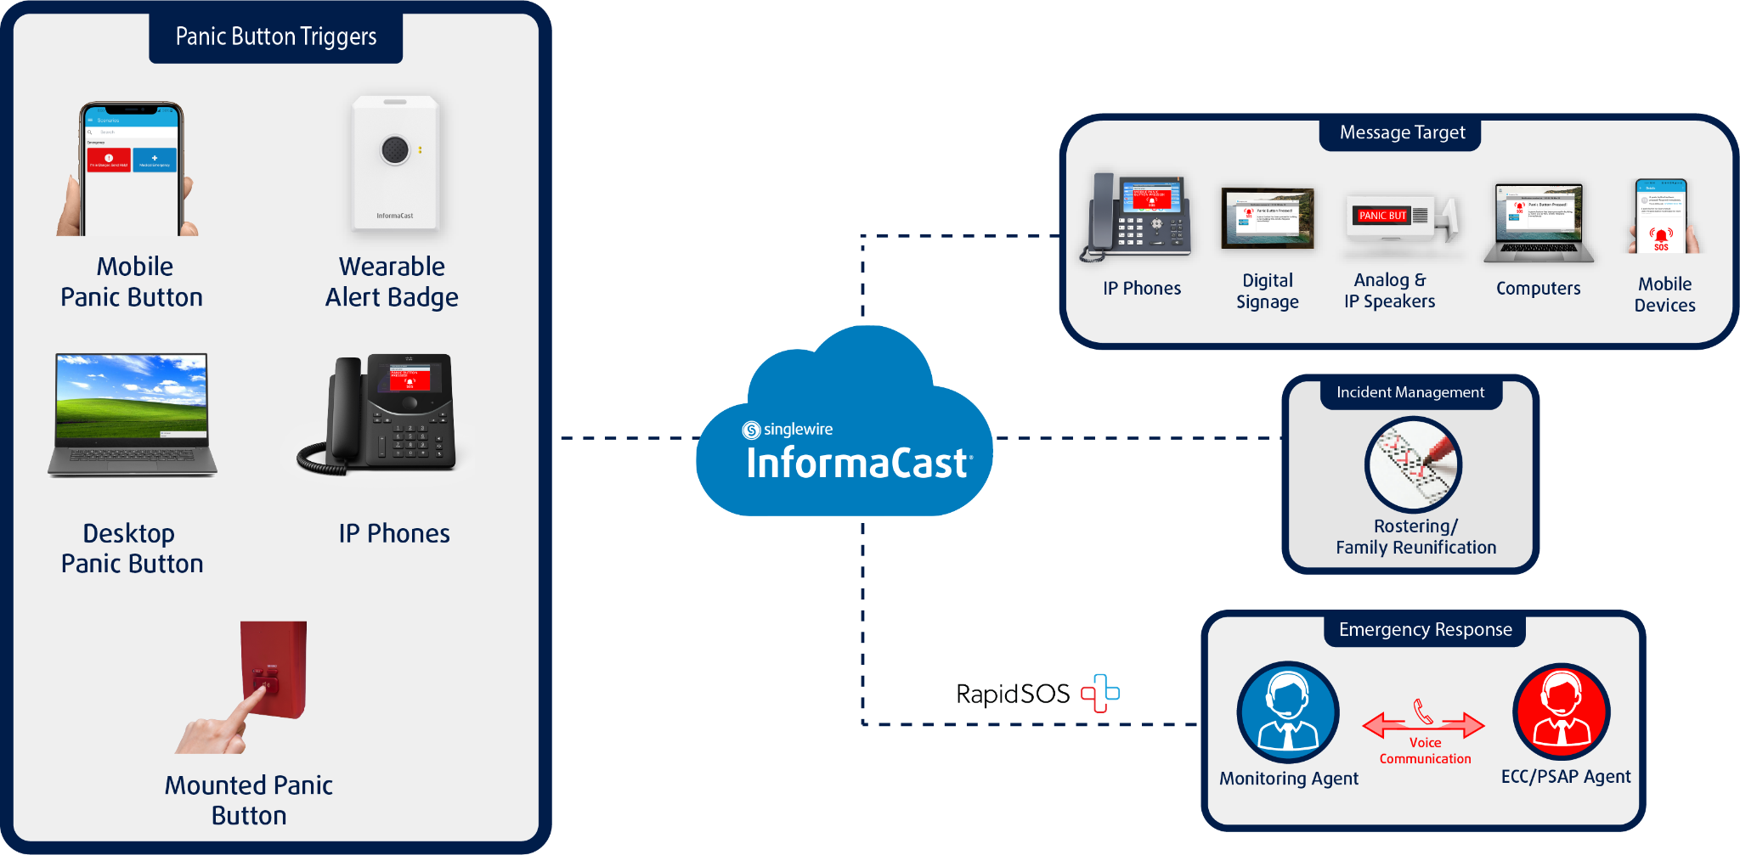
Alyssa’s Law Compliance
Proposed state and federal regulations requiring this type of solution
Want to be proactive in addressing the requirements
All panic button options can trigger a silent notification
Panic button trigger can include a push to RapidSOS for 911 dispatcher notification

Slide 13
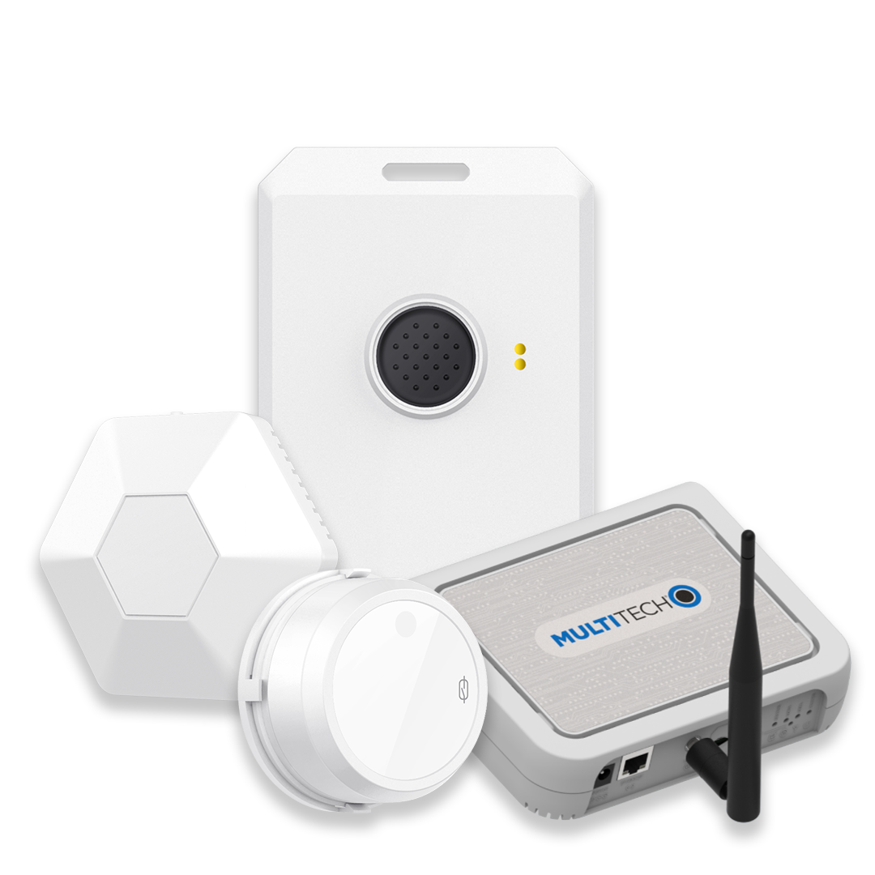
Adding to Our Environment
Directly integrates with existing InformaCast software
Uses LORAwan/BLE Technology
Dedicated system separate from school wifi/network
It includes:
InformaCast Wearable Alert Badges
Assigned to each staff member
BLE Beacons and Supervisors
Placed around the school to provide floor- and room-level accurate location information and system/battery monitoring
LoRaWAN Gateway
Single device that acts a path to the cloud to send alert, location, and ID info to InformaCast

Slide 14
Cost
Price is based on number of staff and number of buildings
It includes all the hardware, software and professional services needed for deployment
Hardware is a capital expense rather than being billed as a recurring service
Initial upfront expense but more savings long term compared to other offerings

Slide 15
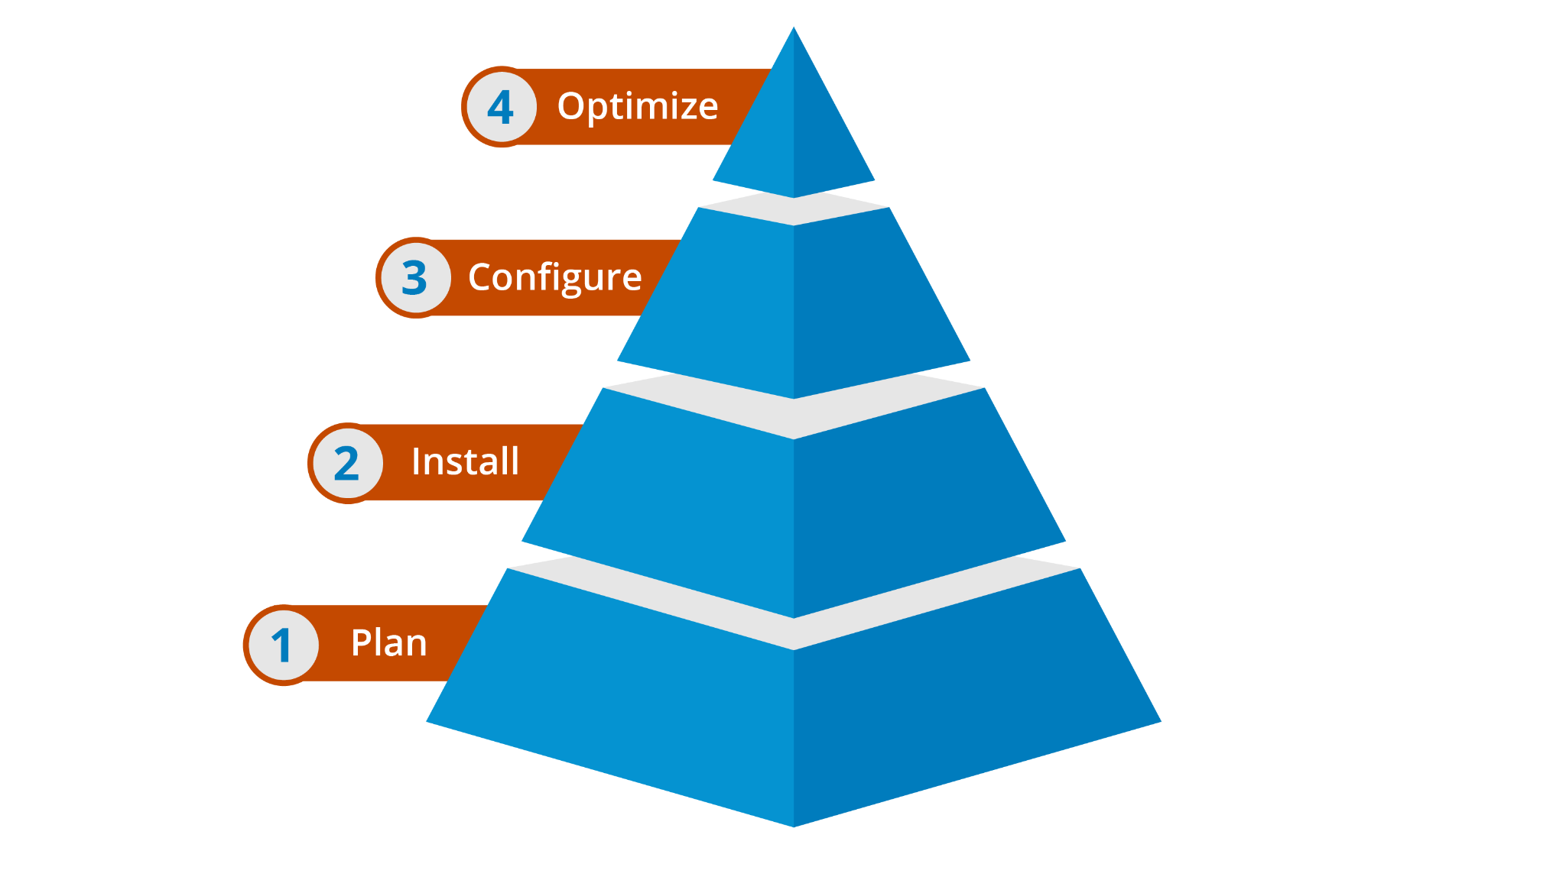
Implementation & Support
Singlewire delivers a proven deployment process by partnering with our IT and safety teams to:
Establish a safety and communication plan
Install, setup, and test
Configure foundational features
Optimize the system to achieve the most value
Additional personalized training is also available
All customers have access to vast on-demand virtual library of resources

Slide 16
Thank you!

